Slide 1
Digital Signal Processing
Dr. Michael Nasief
Lec 4

Slide 2
Prob 1
A linear discrete-time system is characterized by its response h_{k}(n) to a delayed unit sample
For the linear system defined below, determine whether or not the system is shift-invariant

Slide 3
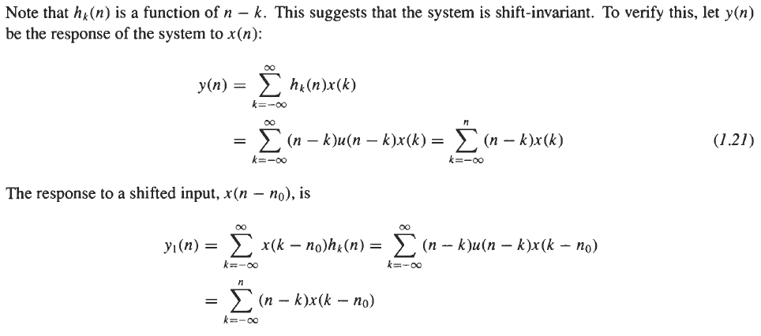
Before

Slide 4
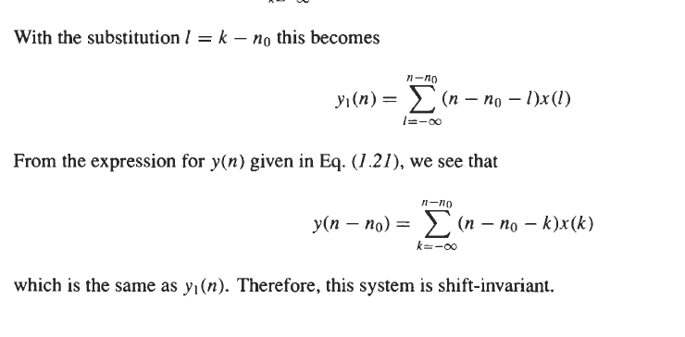
After

Slide 5
Prob 2
Determine whether or not the systems defined in Prob. 1 are
stable
causal.

Slide 7
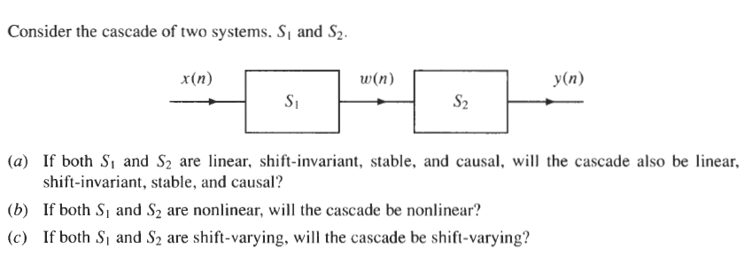
Prob 4

Slide 9
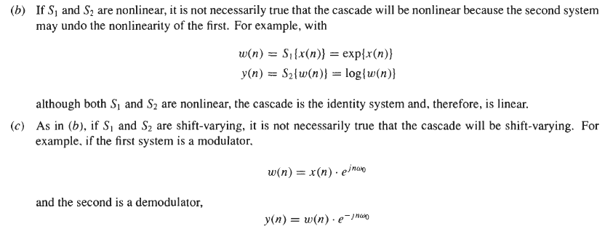

Slide 10
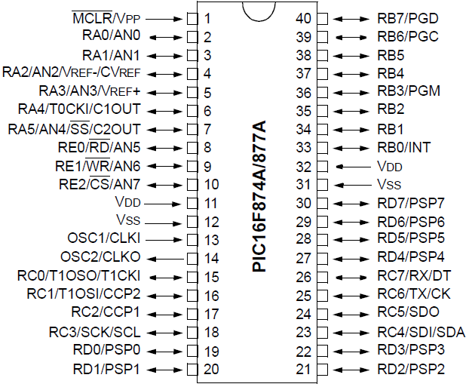
Microcontroller

Slide 11
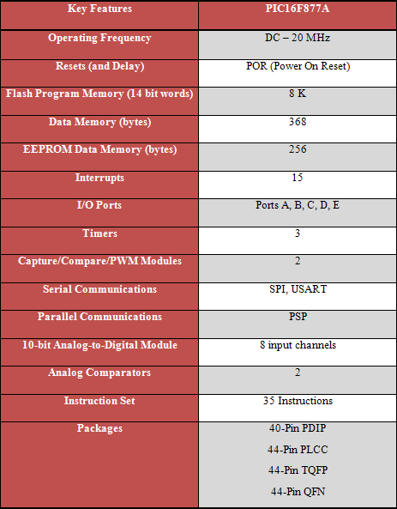
Features

Slide 13
Basic Sub Projects
Digital output
Digital Input
Key Pad
LCD
Analog to Digital
Serial Communication
PC Interface

